Slide 1
METAMATERIAL-ENABLED WIRELESS POWER TRANSFER SYSTEM
“A PATH TOWARDS FUTURE ENERGY SOLUTIONS”

Slide 2
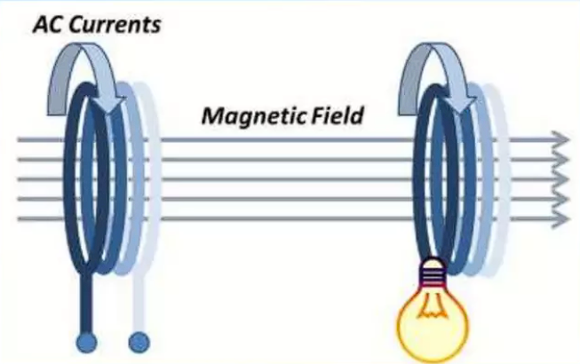
What is WPT?
Wireless power transfer (WPT), wireless energy transmission (WET), or electromagnetic power transfer is the transmission of electrical energy without wires as a physical link.
In this system a transmitter device, transmits power to a receiver device, through the phenomenon of electromagnetic induction.

Slide 3
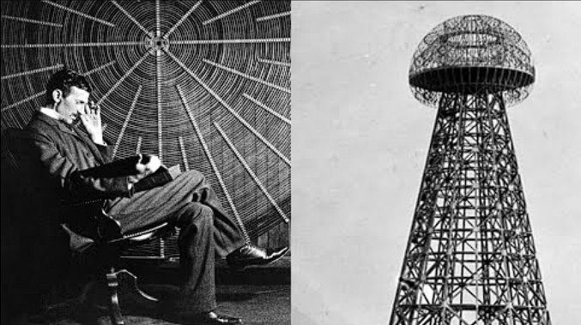
History
In 1890, Nikola Tesla concluded that power could be transferred between two objects wirelessly via an electromagnetic field.
He demonstrated wireless transmission by "electrostatic induction" during an 1891 lecture at Columbia College.
He had a vision for "world wireless system"
Wardenclyffe Tower- Tower built to achieve this purpose.

Slide 4
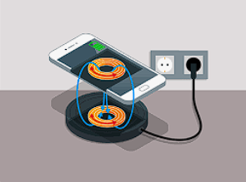
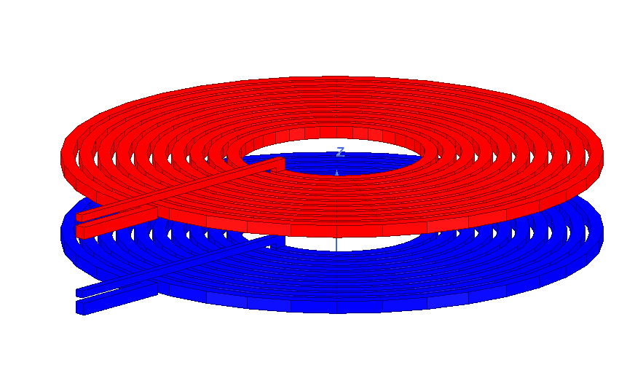
Types Of WPT :-
02
01
Near field WPT
Far field WPT
Uses at inductive coupling WPT
High efficiency
Radiative power emitted from a transmitter
Lower efficiency
Receiver Coil
Transmitting Coil

Slide 5
Problem Statement
Traditional WPT systems suffer from low efficiency due to weak magnetic coupling and field leakage.
This project enhances WPT using metamaterials to improve magnetic field confinement, boost power transfer efficiency, and reduce EMI

Slide 6
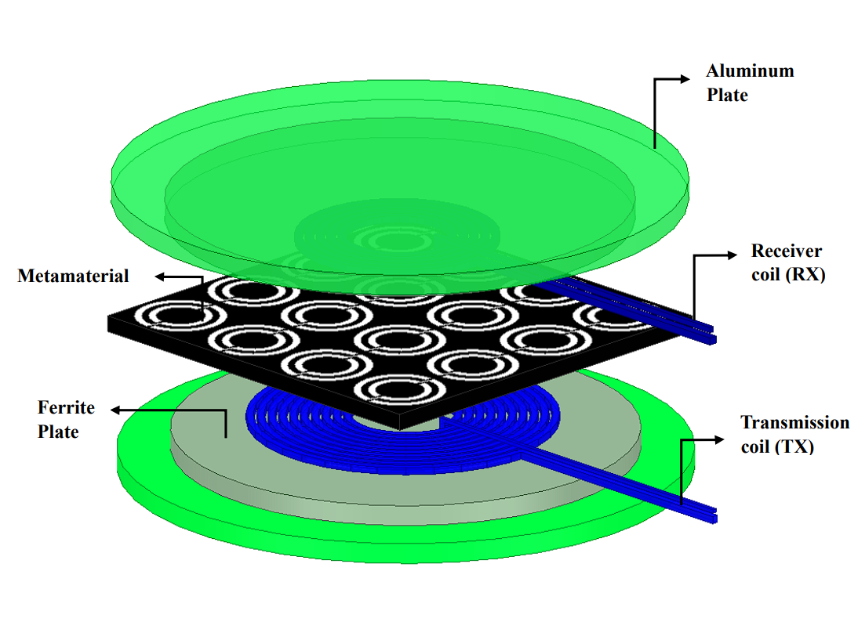
PROPOSED METAMATERIAL – ENABLED WPT SYSTEM
Higher efficiency by improving magnetic field confinement.
Extended range due to enhanced magnetic coupling.
Reduced EMI by controlling field propagation with metamaterial.
Minimized losses as metamaterials guide energy effectively.
More efficient for smart watches, mobile phones, laptops.

Slide 7

Why We Uses Metamaterial?
Compact and Lightweight
Improved Wave Manipulation
Higher Efficiency
Enhanced energy transfer with reduced power loss.
Optimized design for space-constrained applications.
Precise control of electromagnetic wave propagation.

Slide 8
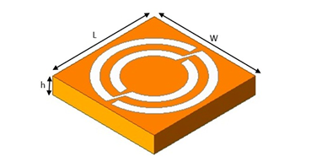
Strecture Of Metamaterial
Circular Meta Slab
Human-made material that can have special properties that do not exist in natural materials.
EXAMPLE:
Negative-Index Metamaterials (NIMs)
Electromagnetic Cloaking Metamaterials
Metasurfaces
Split-Ring Resonators (SRRs)

Slide 9
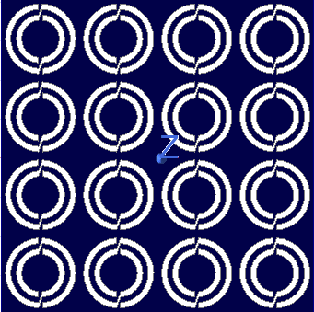
Overview Of The Project
Improve the efficiency of WPT using metamaterials.
Simulated the system using ANSYS to study magnetic fields and power transfer.
Metamaterials help focus magnetic fields, reducing energy loss and boosting efficiency.
Better WPT systems for real-world uses like electric cars, wearable tech, and more!
Substrate : FR4-Epoxy
Slab : Copper

Slide 10
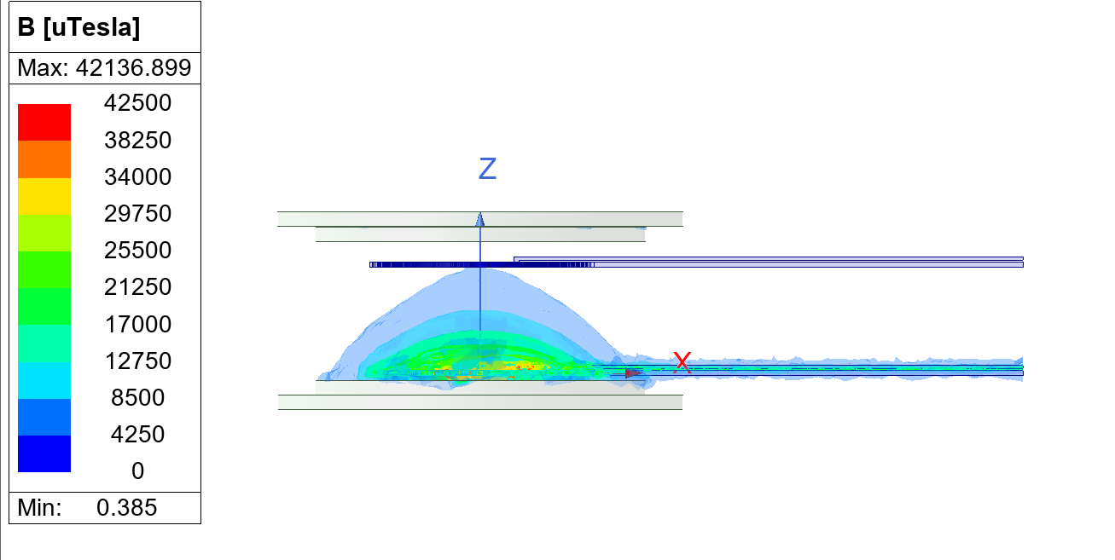
WPT Without Metta
WPT without metamaterials results in lower efficiency due to increased power loss during energy transfer, while the system remains bulky and heavy, requiring larger coils and components. Additionally, the absence of metamaterials limits wave control, leading to poor manipulation of electromagnetic fields and reduced overall performance

Slide 11
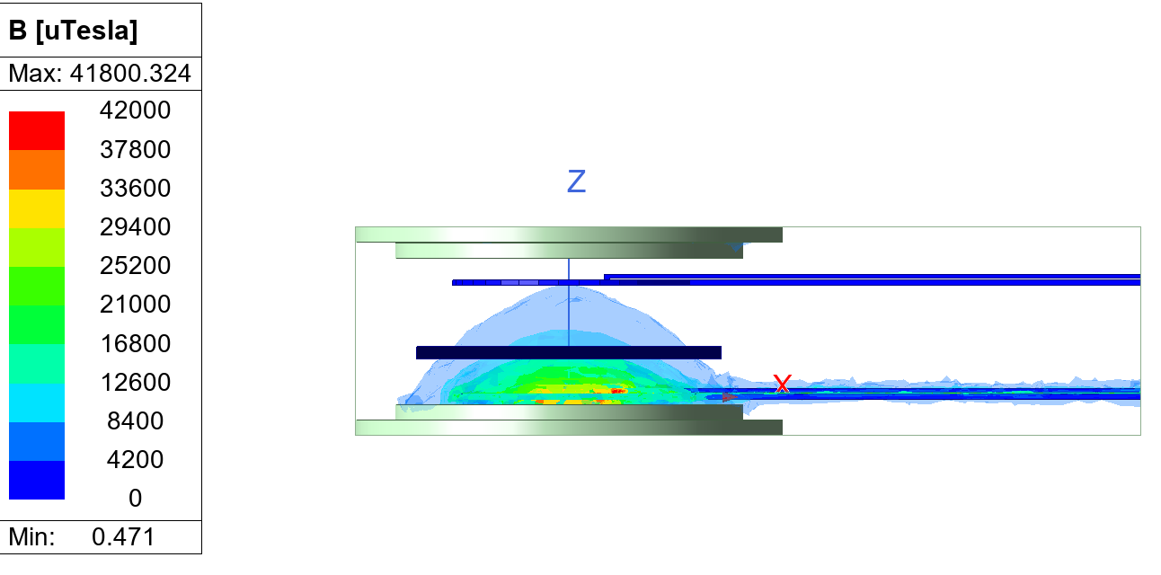
WPT With Onesided Metta
With one-sided metamaterials, the WPT system experiences slightly lower efficiency compared to the setup without metamaterials, as the metamaterial layer acts as an absorber. This absorption leads to partial energy loss, reducing the overall power transfer while providing minimal wave manipulation benefits

Slide 12
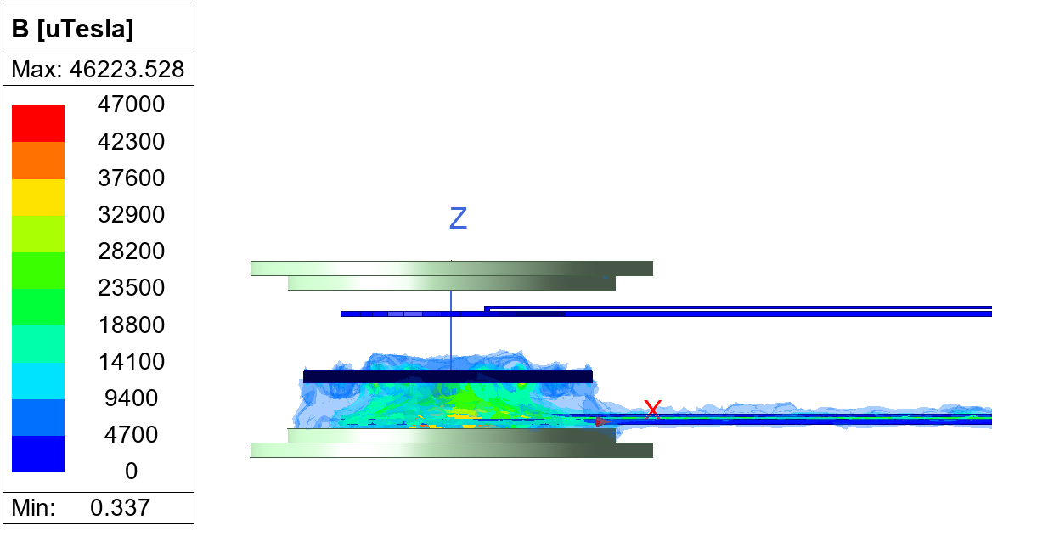
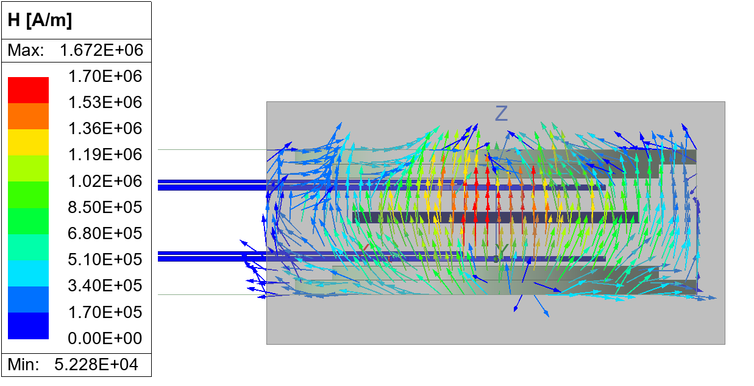
WPT With Doublesided Metta
With metamaterials on both sides of the WPT system, energy transfer efficiency significantly improves due to enhanced magnetic field confinement and reduced power loss. The system becomes more compact and lightweight, while symmetrical wave manipulation ensures uniform energy distribution, maximizing overall performance and reliability
a) Magnectic Flux Density
b) Magnectic Flield Density

Slide 13
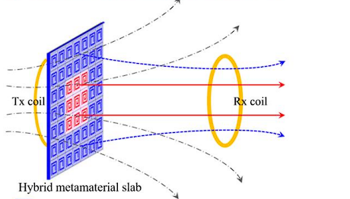
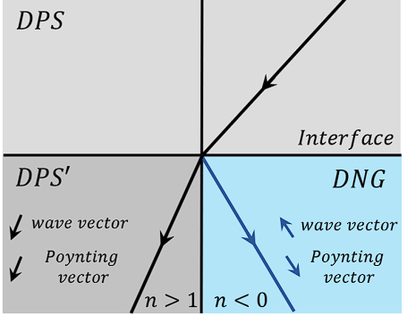
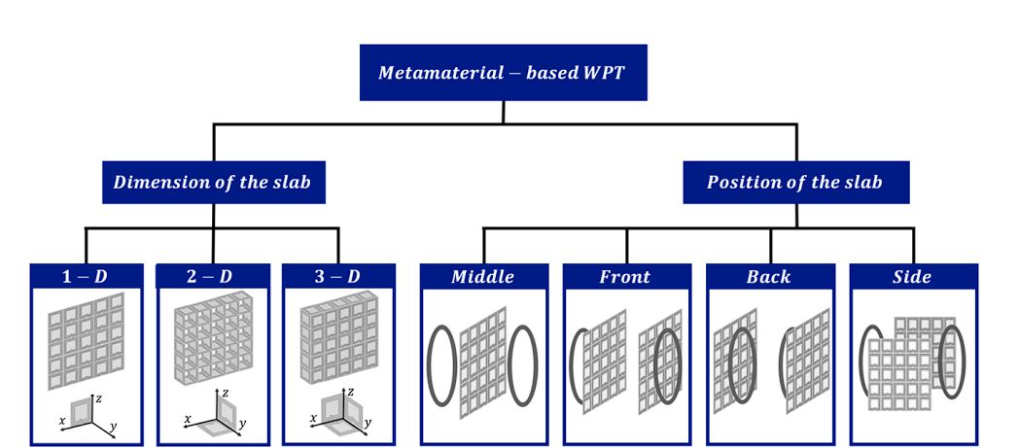
How Does It Works
The wave vector and Poynting vector align, while in the DNG region, they oppose due to the negative refractive index. This unique behavior enhances near-field coupling, improving power transfer efficiency and field confinement.

Slide 14
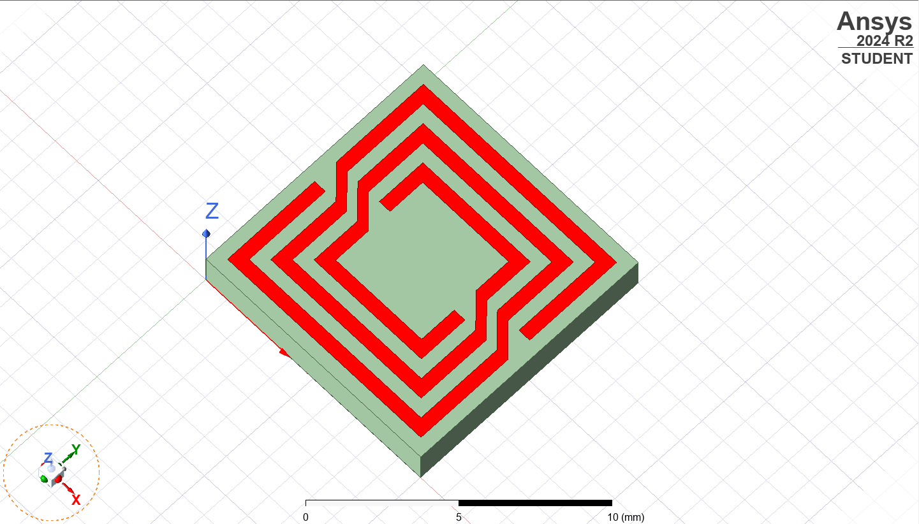
Square Metta & Circular Metta
Parameter | Square Slab Metamaterial | Circular Slab Metamaterial
Power Transfer Efficiency (%) | 70 – 80% | 85 – 90%
Field Confinement (%) | 60 – 70% | 80 – 90%
Material Usage (cm²) | 100 – 120 cm² | 90 – 100 cm²
Heat Dissipation (°C) | 5 – 10°C increase | 3 – 7°C increase
Weight (g) | 50 – 70 g | 40 – 60 g

Slide 15
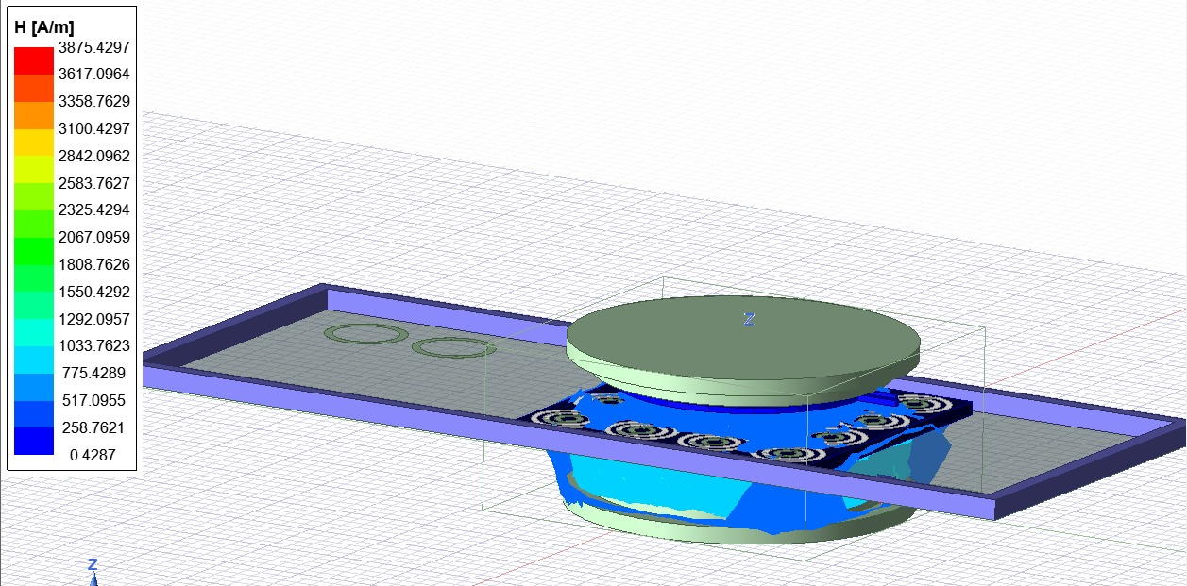
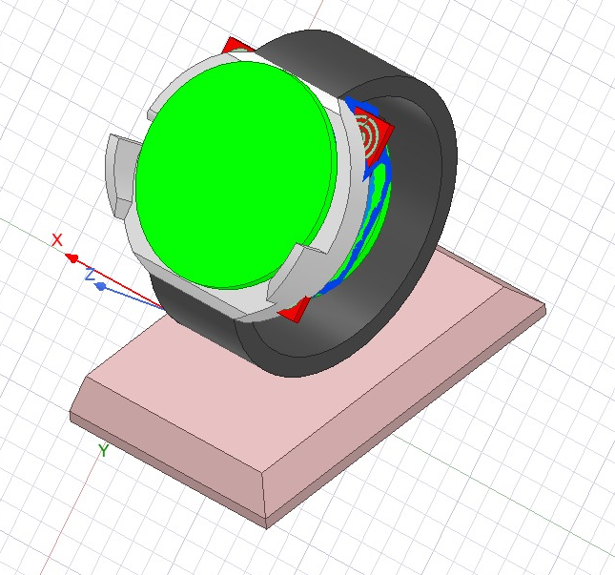
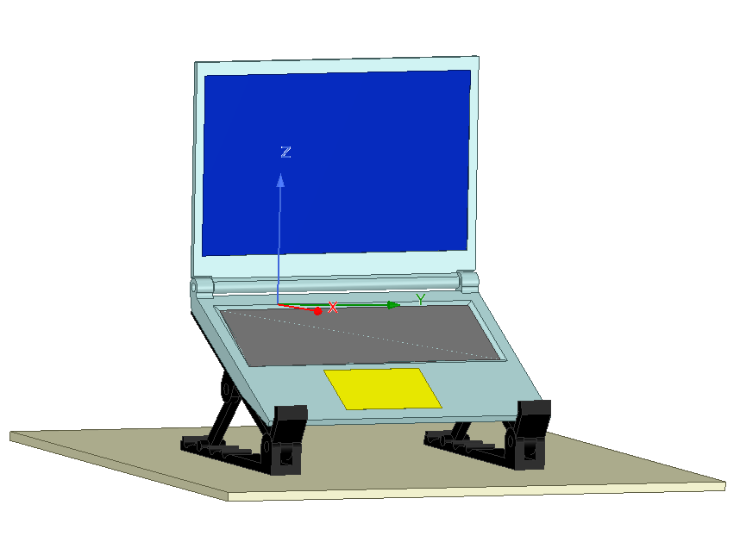
Real-Time Application
Metamaterials focus magnetic fields for efficient energy transfer, enabling faster smartphone charging. They also allow flexible coil alignment for user convenience
Compact metamaterial structures enhance power transfer to small devices like smartwatches. This ensures efficient charging with minimal heat generation.
Metamaterials improve power transfer over longer distances for laptop charging. This allows seamless charging on desks without direct cable connections

Slide 16
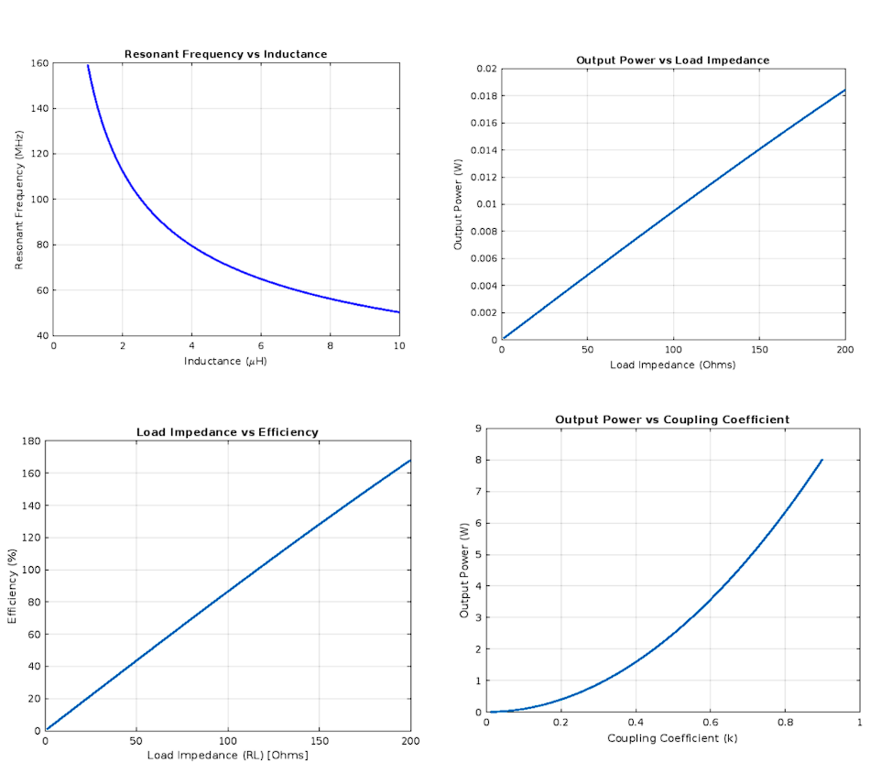
MATLAB Verification
Resonant Frequency VS Inductance
Output Power VS Load Impedance
Load Impedance VS Efficiency
Output Power VS Coupling Coefficient

Slide 17
Thanks!

